Slide 1
目標
1.建立SSH連線
2.讀取GPIO與DHT11溫濕度感測器
3.建立MQTT服務
3.建立Node Red Dashboard

Slide 2
燒入器
Imager
https://www.raspberrypi.org/blog/raspberry-pi-imager-imaging-utility/
SSH Enable(If you want ssh enabled in the first time)
https://howchoo.com/g/ote0ywmzywj/how-to-enable-ssh-on-raspbian-without-a-screen

Slide 3
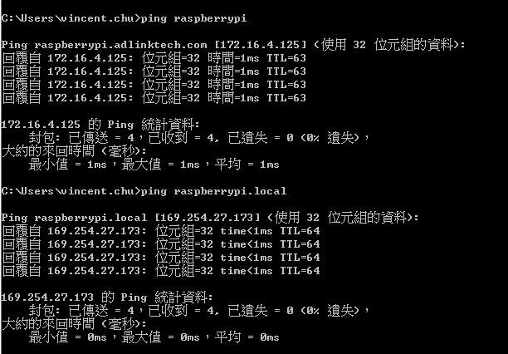
Linklocal

Slide 4
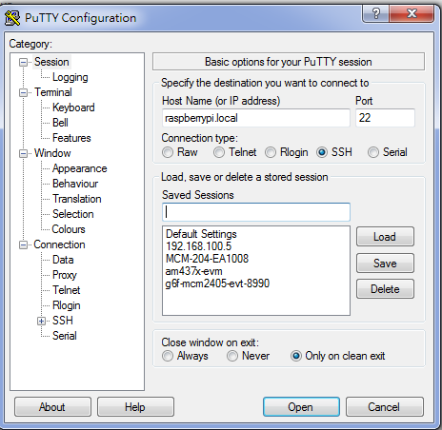
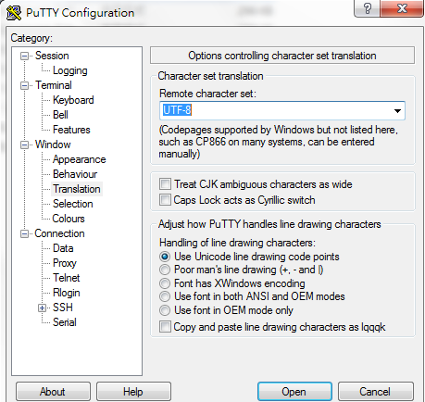
SSH
Raspbian默认的用户名密码是pi/raspberry

Slide 5
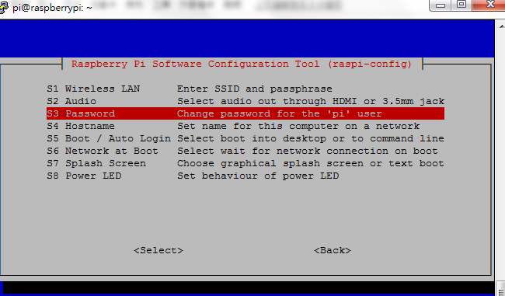
Password
改密碼
https://www.shellhacks.com/raspberry-pi-default-password-how-to-change/
raspi-config

Slide 6
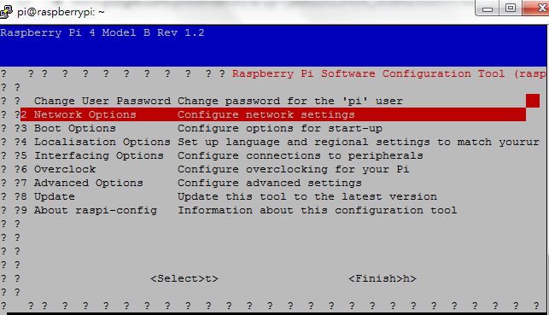
Network
設定好WiFi會方便點

Slide 7
常用指令及目錄整理
https://www.itread01.com/p/142367.html
※目前我們只需要cd\ls\rm\cat就可以了

Slide 8
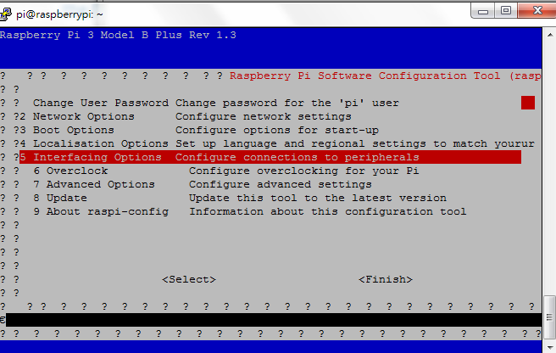

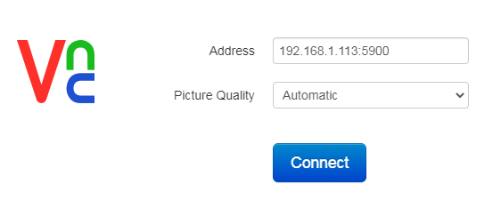
VNC
https://chrome.google.com/webstore/detail/vnc%C2%AE-viewer-for-google-ch/iabmpiboiopbgfabjmgeedhcmjenhbla/related
如果不行 可以改解析度看看

Slide 9
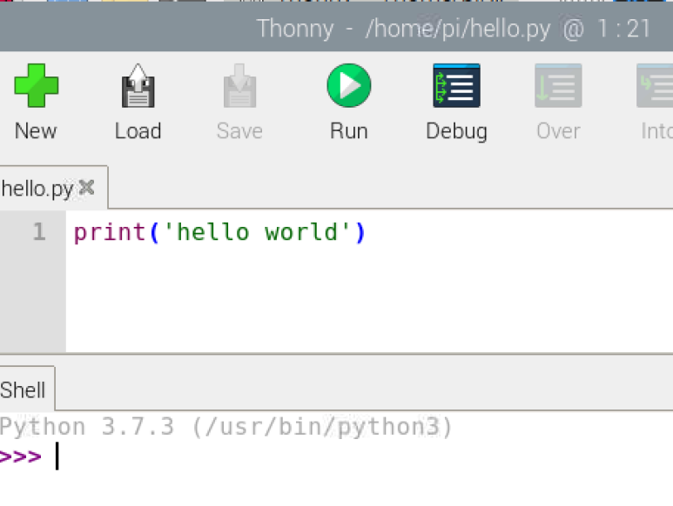
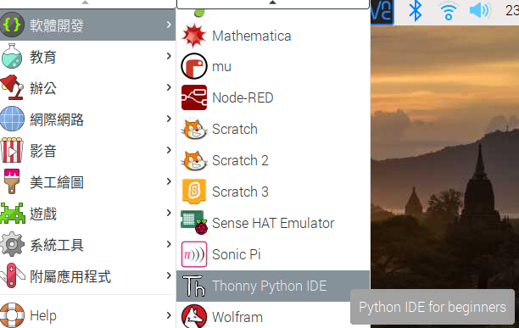
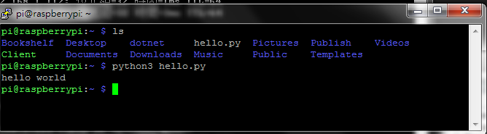
Python hello world

Slide 10
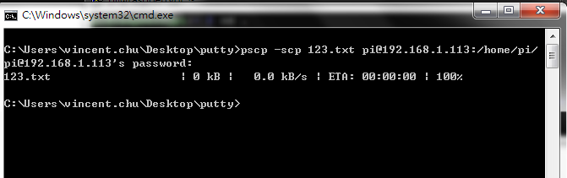
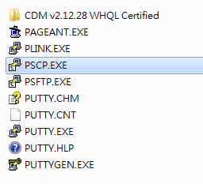
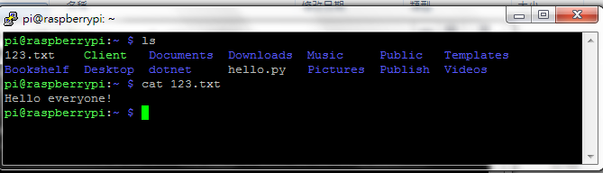
SCP
如果想上傳檔案進RPI
https://www.chiark.greenend.org.uk/~sgtatham/putty/latest.html

Slide 11
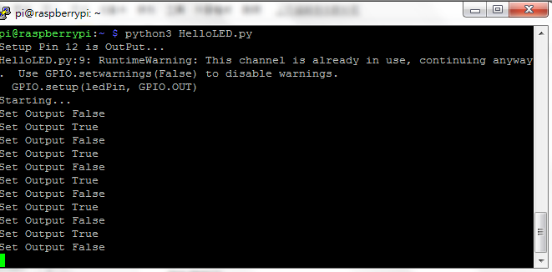
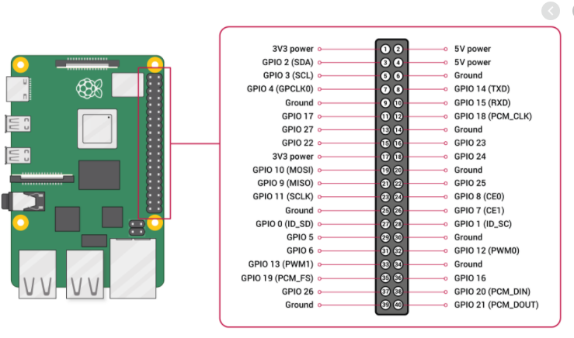
GPIO
import RPi.GPIO as GPIO
import time
# Use physical pin numbers
GPIO.setmode(GPIO.BOARD)
# Set up header pin 12 (GPIO18) as an input
ledPin = 12
print "Setup Pin 12 is OutPut..."
GPIO.setup(ledPin, GPIO.OUT)
print "Starting... "
while True:
print "Set Output False"
GPIO.output(ledPin, False)
time.sleep(1)
print "Set Output True"
GPIO.output(ledPin, True)
time.sleep(1)
試著自行改成GPIO11~GPIO12對接跑跑看

Slide 12

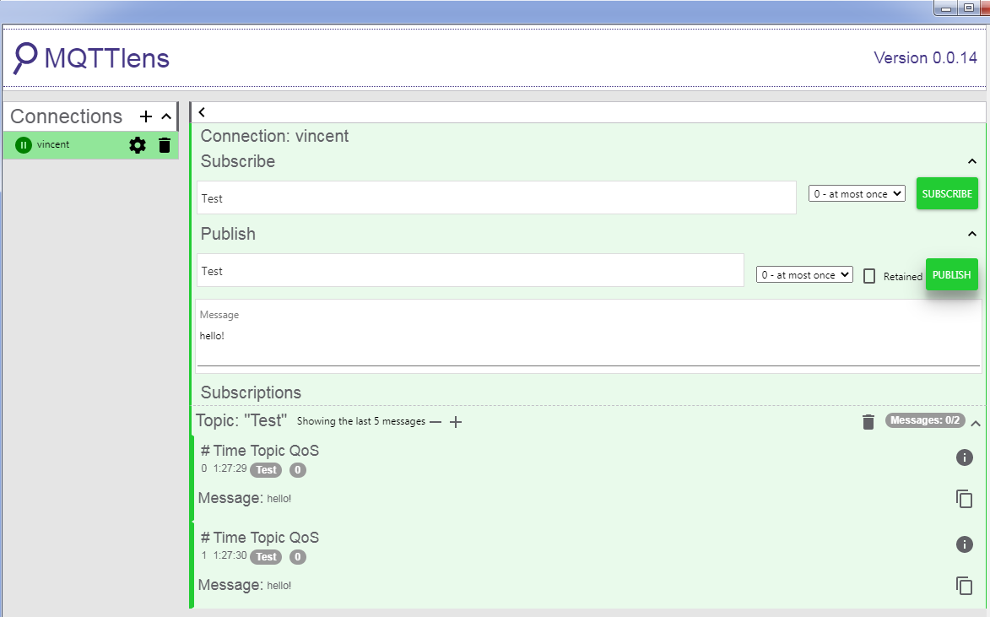
MQTT
Mosquitto Broker
apt-get install mosquitto mosquitto-clients
service mosquitto status
Client via chrome

Slide 13
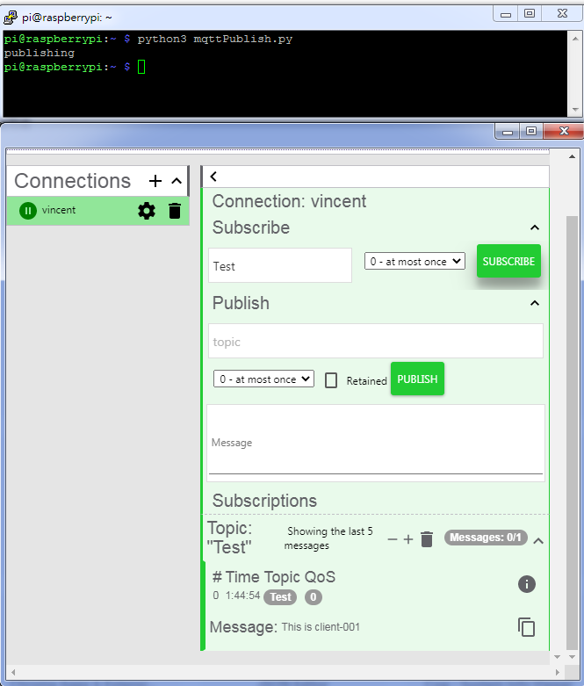
Publish MQTT Message
import paho.mqtt.client as paho
broker="127.0.0.1"
client= paho.Client("client-001")
client.connect(broker)
print("publishing ")
client.publish("Test","This is client-001")
client.disconnect()
自行安裝模組: pip3 install paho-mqtt

Slide 14
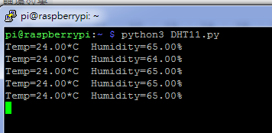
DTH11溫濕度感測器
使用模組: pip3 install Adafruit_DHT
用nano編輯 : nano DHT11.py
Example:
import Adafruit_DHT
DHT_SENSOR = Adafruit_DHT.DHT11
DHT_PIN = 4
while True:
humidity, temperature = Adafruit_DHT.read_retry(DHT_SENSOR, DHT_PIN)
if humidity is not None and temperature is not None:
print("Temp={0:0.2f}*C Humidity={1:0.2f}%".format(temperature, humidity))
else:
print("Failed to retrieve data from HDT11 sensor")
RPI 4B的陷阱:
https://stackoverflow.com/questions/63030355/can-the-adafruit-dht22-library-be-modified-to-support-raspberry-pi-4-model-b-bc

Slide 15
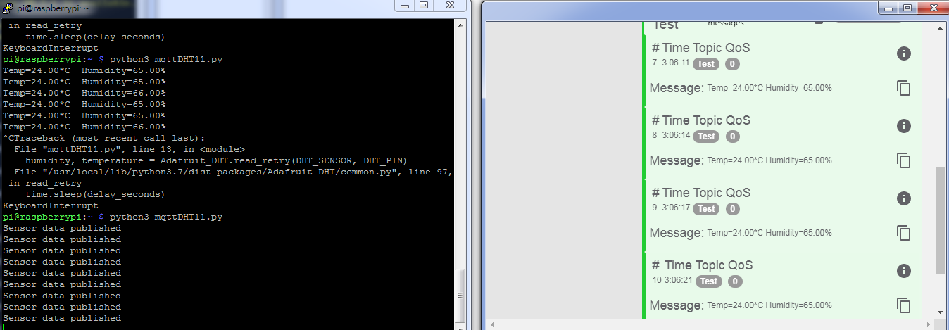
作業(DTH+MQTT)

Slide 16
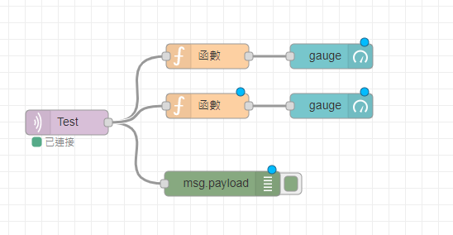
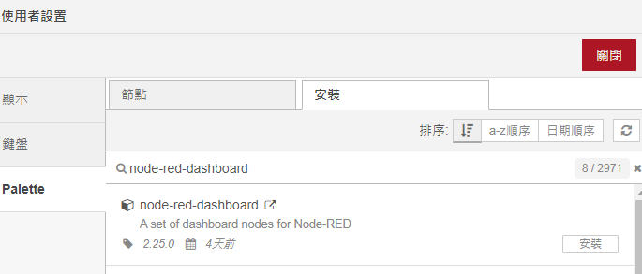
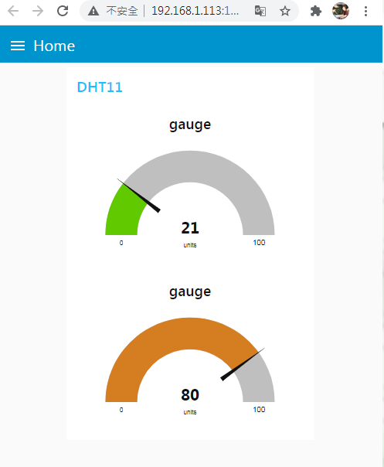

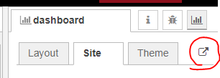
node-red
apt-get install nodered
node-red-start
http://192.168.1.113:1880
將原本的MQTT溫溼度資料先改成Json格式
再設計function

Slide 17
關機
sudo shutdown -h now

